Slide 1
LibGuides CMS
Facilitated by: Jenn Cournoyer, M’lyn Hines, Pauline Clifford, Jarrod Borek, Brian Donohue-Lynch, & Cindi Brassington

Slide 2
What is LibGuides CMS?
LibGuides is a content management system used by libraries worldwide
LibGuides CMS : http://buzz.springshare.com/producthighlights/whylgcms/overview

Slide 3
Why use it?
LibGuides CMS allows for flexibility in layout
You are not restricted by the College website templates
You don’t need to know how to code in HTML or CSS
You have direct control over your LibGuides

Slide 4
Today’s Objectives
Set up your profile
Create a new guide or copy from an existing guide

Slide 5
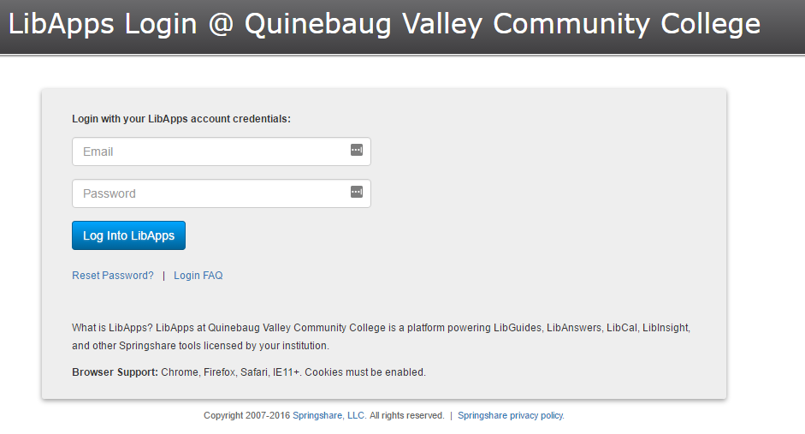
Let’s Log in!
https://qvcc.libapps.com/libapps/login.php

Slide 6
Your Profile
Avatar-no shadow pics, please
Contact information

Slide 7
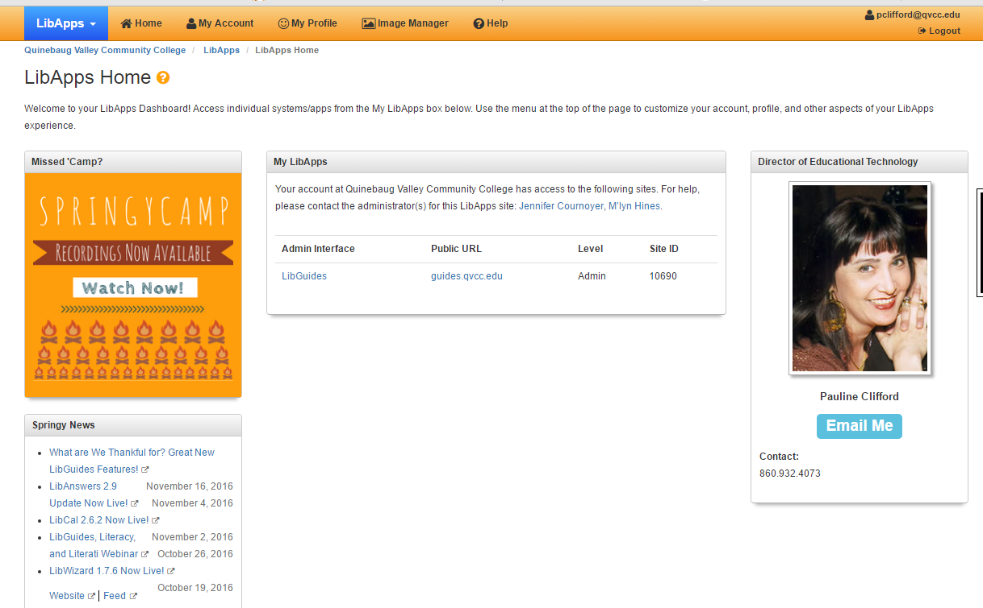

Slide 8
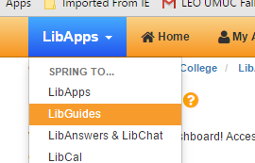
Getting to LibGuides

Slide 9
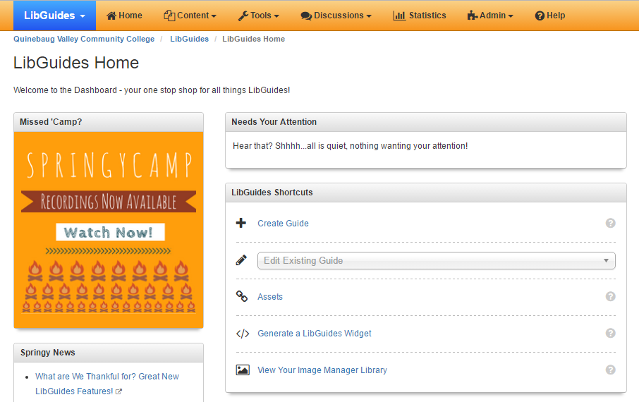
Create a Guide

Slide 10
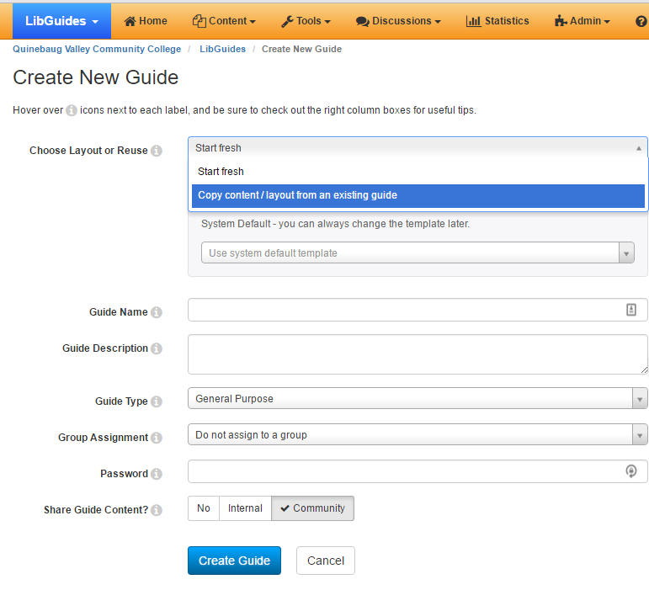
Copy an Existing Guide

Slide 11
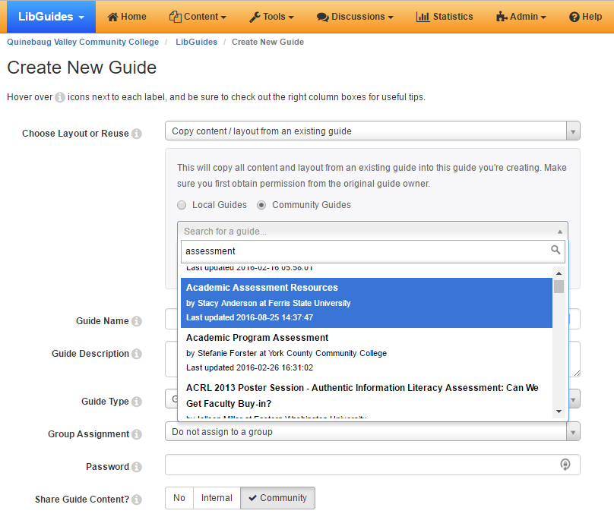

Slide 12
Copy an Existing Guide
Search local or community guides
LibGuides Community
http://community.libguides.com/
http://bestof.libguides.com/home
Get permission from the owner via email

Slide 13
Types of Guides
Promotion & Tenure LibGuides
Research- & Project-Related LibGuides
Professional Development & Conference LibGuides
Newsletter LibGuides
Blog LibGuides (Alfred & Carlee)
Assessment LibGuides (Brian DL!)
New Faculty or New Employee LibGuides

Slide 14
Sample LibGuides
Jenn Cournoyer

Slide 15
Sample LibGuides
M’lyn Hines

Slide 16
Do’s and Don’ts

Slide 17
Do’s
Less is more
Sound bytes, not paragraphs
Layout
F-shape scanning
Scroll line
Clean layouts, whitespace
Relevant images or video
Make it Readable Scan-able
Font: sans serif
Font size: 60-72 characters per line
Color: use sparingly, check contrast
Consistency: headings, sub-headings, body-text
Interactivity
Contact Information
Student Review

Slide 18
Don’ts
Don’t be a silhouette
Don’t create speed bumps
Don’t explain the obvious
Don’t bury the main point
Don’t fill the screen with text
Don’t use a passive voice
Keep bold and italics to a minimum
Don’t impose detours
Avoid multiple tabs – unseen & unused
Avoid hiding your message below the scroll
Don’t confuse the user
Avoid underlining for emphasis – it looks like a hyperlink

Slide 19
Assorted & Sundry
File upload size: 20MB
About 10GB per LibGuide
Remember to give credit when you use a video, image, etc.
Where can I find open access images? There’s a LibGuide for that! Confused about licensing? Click here.
You can also do a quick search by image license on Google!

Slide 20
Questions?

