Slide 1
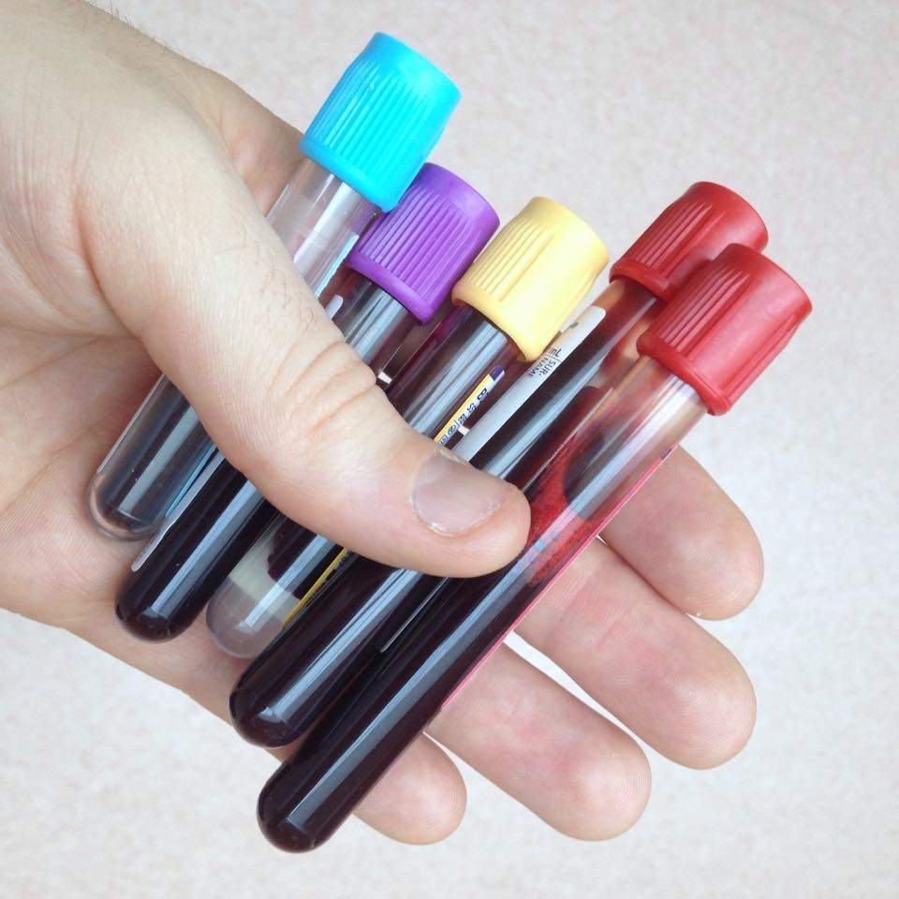
Ever wonder what happens to your blood tubes after you’ve had your blood drawn?

Slide 2
What is the Clinical Laboratory?
Department of the hospital where blood and other body specimens are processed for testing
Routine wellness testing
  Urinalysis
Screening for diseases
  Cardiac Risk Profile
Diagnosing diseases
  Glucose Tolerance Test

Slide 3
Specific Departments
Chemistry
Hematology
Coagulation
Microbiology
Immunology/
Serology
Urinalysis
Blood bank

Slide 4
Medical Laboratory Technician
Also known as clinical laboratory technician
2 year associates degree
Performs wide range of laboratory tests
Nationally certified

Slide 5
Job Outlook – US Bureau of Labor Statistics
Phlebotomists – expected to grow by 25% from 2014-2024
  Median annual salary $31,000 ($15/hr)
Medical Laboratory Technician – expected to grow 16% from 2014-2024
  Median annual salary $50,550 ($24.30/hr)
Clinical Laboratory Scientists – expected to grow by 16%
  Median annual salary $65,000 ($31/hr)

Slide 6
Curriculum
General Education Courses/Pre-requisites
English Composition
Intermediate Algebra or higher
Medical Terminology
Chemistry
Human Biology
Medical Law & Ethics
Humanities elective
Social Science elective

Slide 7
Curriculum
Core Courses
Intro to Clinical Lab
Techniques of Phlebotomy
Urinalysis and Body Fluids
Clinical Hematology & Coagulation
Clinical Chemistry
Clinical Immunohematology & Serology
Clinical Microbiology
Internships – 400 hours

Slide 8
Students
Interested in health care but not necessarily a lot of patient care/interaction
An affinity for science/biology
A pre-nursing student who has not been accepted to nursing school
Phlebotomists - may earn credit for experience as a phlebotomist
Medical assistants
Biology or Chemistry majors

